Slide 1

ABC CALL VOLUME TREND ANALYSIS
-Nikhil Yadav

Slide 2

Table of Contents
Project Description
Project Objectives
Approach
Methodology and Tech-Stack Used
Assumptions
Insights
Key Findings
Conclusions
Achievements

Slide 3

Project Description
The project was completed with insights following a few major steps,
Project Focus: Analyzing Customer Experience ( CX) in an inbound
calling team with a 23 - day dataset, covering agent details, queue t imes, call t imes, call duration, and call status.
CX Te am Importance : Highlighting the v i tal role of CX teams in
collecting, analyzing, and sharing customer insights within an
organization.
AI- Driven CX Tools: Recognizing the use of AI - powered tools l i ke IVR, RPA, Predictive Analytics, and Intelligent Routing to enhance customer experiences.
Inbound Support Goal: Emphasizing the objective of inbound
customer support to attract, engage, and delight customers, ultimately building loyal advocates for the business.

Slide 4


Project Objectives
The project was divided into four major objectives :
Dataset Overview: The dataset contains 117 , 989 rows and 13 columns, providing detailed information about inbound calls to ABC Insurance
Company.
Average Call Duration : To Calculate the average call duration for each t ime bucket to gain insights into call handling efficiency .
Call Volume Analysis: To Create a graph or chart to v i sually represent the number of calls received across different t ime buckets, enabling a c lear
understanding of call volume patterns.
Manpower Planning ( Day Shift): To Devise a workforce a l location plan for
each t ime bucket during the day to reduce the abandon rate to 10 %,
ensuring at least 90 out of 100 calls are answered.
Manpower Planning ( Night Shift): To Propose a plan for handling the 30
nighttime calls to maintain a maximum abandon rate of 10 %, enhancing the
overall customer experience.

Slide 5

Approach
Data Analysis Techniques: Utilized Advanced Excel formulas and statistical methods to conduct in - depth data analysis, extracting meaningful insights f rom the dataset.
Assumption- Based Modeling: Incorporated relevant assumptions, such as employee working hours ( excluding breaks and downtime), to facilitate
accurate calculations and decision - making.
Visualized Results : Employed charts and graphs to v i sually represent and communicate the project' s f indings, making complex data more accessible and actionable.
Mathematical Precision: Applied r i gorous mathematical techniques to ensure the accuracy of results and support informed decision - making within the project.
Holistic Approach : Considered a comprehensive v iew of call center
operations, including both day and night shifts, to optimize manpower a l location and enhance the customer experience.

Slide 6

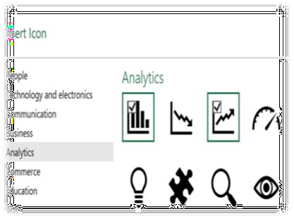


Methodology and Teach-Stack Used
Tool Stack: Leveraged Microsoft Excel 2021 for data manipulation and analysis, Microsoft Power Point for presentation, and utilized the Data Analysis tool within Excel.
Functional Expertise : Employed a diverse range of Excel functions
and statistical tools to conduct a comprehensive analysis, extracting valuable insights from the dataset.
Real- World Context : Incorporated real- l i fe assumptions from IT offices and work strategies to ensure practical and relevant
outcomes for decision- making.

Slide 7

Assumptions
Agent Workweek : Agents work 6 days a week.
Unplanned Leaves : On average, each agent takes 4 unplanned leaves per
month.
Working Hours : An agent' s total working hours are 9 hours per day.
Break Time : Agents spend 1 . 5 hours on lunch and snacks during office
hours.
Call Handling Time : On average, agents spend 60 % of their actual
working hours ( 60 % of 7 . 5 hours) on calls with customers/ users, here I have considered i t 6 hours.
Monthly Days : The total number of days in a month i s assumed to be 30 .
IT Downtime and Meetings : Deducting t ime for IT errors, device
downtime, and meetings, agents have an actual working duration of 6 hours per day.

Slide 8
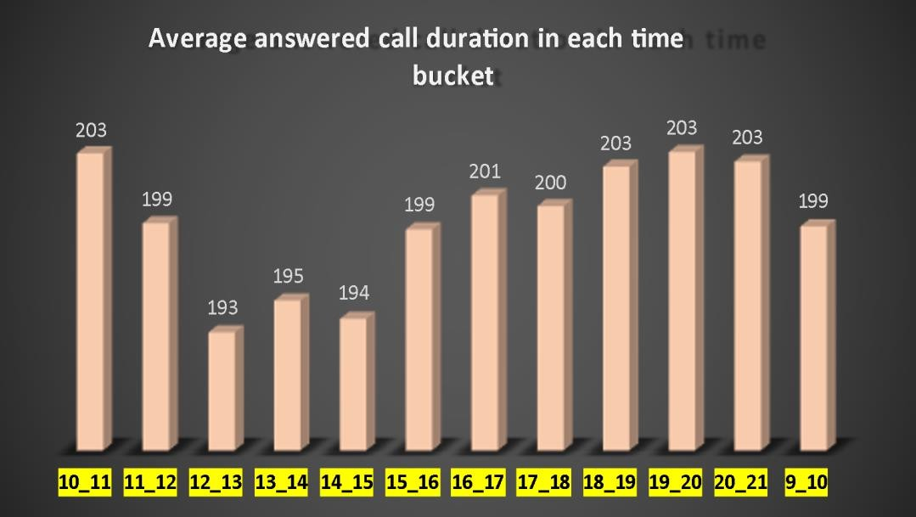
Insight-1:Visualizing Average Call Duration across Time Buckets
Calculation :https://docs.google.com/spreadsheets/d/1SzR0Lxn03zZjAvqcyaH_n-_14UTrFYOa/edit?usp=drive_link&ouid=113244944505200268977&rtpof=true&sd=true
The graph shows the average call duration distribution in
each time bucket of the Day shif t.
The lowest average duration
is seen on 12 to 1 PM and the highest is seen on Morning
and Evening buckets.
The average duration is
calculated on ANSWERED calls
only.

Slide 9












Insight-2:Visualizing call volume across Time Buckets
Calculation:https://docs.google.com/spreadsheets/d/1SzR0Lxn03zZjAvqcyaH_n-_14UTrFYOa/edit?usp=drive_link&ouid=113244944505200268977&rtpof=true&sd=true
The graph shows the counts
of received calls and their
ratio in each time bucket.
Calls received in each time bucket
The counts of the customer phone numbers were set to the secondary axis and the count of received calls were set to the primary axis.
14.00%
12.00%
10.00%
8.00%
6.00%
4.00%
2.00%
0.00%
12.40%
17000
11.28%
10.72%
15000
9.80%
8.95%
7.76% _{7.45% 7.23%}
8.13%
13000
13313
14626
6.13%
5.48%
11000
11561
4.67%
6463
9000
There is a sharp decrease in count of received calls from 12 Pm af terwards.
12652
10561
9588
8788
5505
7000
9159
8534
7238
5000
10_11 | 11_12 | 12_13 | 13_14 | 14_15 | 15_16 | 16_17 | 17_18 | 18_19 | 19_20 | 20_21
9_10
Count of Call_Seconds (s)
Count of Customer_Phone_No

Slide 10


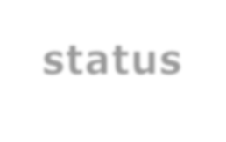



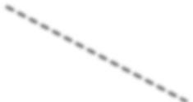
Insight-3:Optimizing Agent Allocation for 10% Abandon Rate
Calculation :https://docs.google.com/spreadsheets/d/1SzR0Lxn03zZjAvqcyaH_n-_14UTrFYOa/edit?usp=drive_link&ouid=113244944505200268977&rtpof=true&sd=true
T h e g r a p h d i s p l a y s c u s t om e r p h o n e n u m b e r c o u n t s, r a t i o
d i s t ri b u t i o n , a n d a v e r a g e c a l l d u r a t i o n s f o r e a c h c a l l s t a t u s ( a b a n d o n e d , a n s w e re d ,
t r a n s fe rr e d )
Count & PCT count of average calls with
status
0.00% 10.00% 20.00% 30.00% 40.00% 50.00% 60.00% 70.00%
100000
T h e r a t i o o f c o u n t s o f t h e
c u s t o me r p h o n e n u m b e rs w a s s e t t o t h e s e c o n d a ry a x i s a n d t h e
c o u n t s o f c u s t o me r p h o n e n u m b e rs a n d a v e r a g e c a l l
d u r a t i o n ( s ) w e r e s e t t o t h e p r i m a ry a x i s .
80.00%
80000
0.96%
82452
60000
1133
69.88%
40000
20000
34403
29.16%
199
76
0
0
T h e n u m b e r o f a n s w e re d c a l l s t o p s
t h e c a l l s t a t u s .
abandon
answered
transfer
PCT Count of Customer_Phone_No
Average of Call duration(s)
Count of Customer_Phone_No

Slide 11
Insight-3: Explanation
Calculation :https://docs.google.com/spreadsheets/d/1SzR0Lxn03zZjAvqcyaH_n-_14UTrFYOa/edit?usp=drive_link&ouid=113244944505200268977&rtpof=true&sd=true
✓
T h e D a t e & T i m f e a t u r e w a s g i v e n w h e r e b o t h D a t e s a n d T i m e w e r e t o g e t h e r , I h a v e e x t r a c t e d t h e D a t e f r o m
t h e f e a t u re i n t o a n e w f e a t u r e n a m e d ' D a t e s ’ . T h e f o r mu l a u s e d i s
f i l l u p a l l t h e c e l l s .
= INT( Cell number)
a n d d r a g g e d i t d o w n t o
✓
T h e n I h a v e c o n v e r t e d t h e D a t e f o r m a t o f D A T E S t o D D - M M ( e . g . : 1 - J A N )
✓
C r e a t e d a p i v o t t a b l e a n d f i l t e re d t h e S u m O f a n u m b e r o f c a l l d u r a t i o n s f o r 1 s t J a n o n l y , d i v i d e d i t b y 3 6 0 0 t o c o n v e rt i t i n t o h o u rs .
T h e h o u r va l u e , 187 . 96 2222 i s d i v i d e d b y 6 s i n c e a n a g e n t w o r k s f o r 6 h o u rs a d a y a n d t h i s r e s u l t g i v e s m e a t o t a l n u m b e r o f a g e n t s w o r k i n g i n a d a y .
✓
A s t h i s a g e n t e f f i c i e n c y i s 6 0 % e f f i c i e n c y , t o b e e f f i c i e n t a s m u c h a s 9 0 % w i t h o n l y 1 0 % a b a n d o n e d c a l l s , t h e n u m b e r o f a g e n t s t h a t w i l l b e r e q u i r e d i s : 4 6 .
✓
D i s t ri b u t e d 4 6 i n s e p a ra t e t i m e b u c k e t s t o g e t t h e d e s i r e d n u m b e r o f r e q u i r e d a g e n t s i n d i f f e r e n t t i m e b u c k e t s .
✓
C o n v e r t e d t h e c o u n t o f c a l l s i n t o o c t a n d t h e n i n t o d e c i m a l s a n d m u l t i p l i e d i t w i t h 4 6 e a c h . R o u n d e d i t l a t e r.

Slide 12
Insight-4: Efficient Manpower Planning for 10% Max Abandon Rate, Including Night Shifts(Estimated)
✓
The a v erage of incoming ca l l s f rom 01 - 01 - 2022 to 23 - 01 - 2022 i s 5129 . 91304
The a v erage i s ca l culated using Excel' s AVERAGE method, The Formula used i s
= AVERAGE( E 4 : E 26 )
M e a n s ,
In 3 0 d a y s , a n a v e r a g e o f 5 1 3 0 c a l l s a r e c o m i n g i n a d a y , a n d a s w e k n o w a d a y ' s 3 0 % o f c a l l s a r e c o m i n g a t n i g h t ,
H e n c e ,
The a v erage number of ca l l s coming a t nig ht i s: 1539 [ Formula used i s
=( 5130 / 100 )* 30 ]
N o w ,
F r o m Q u e s t i o n 1 , W e h a v e a l r e a d y g o t t h e a v e r a g e d u r a t i o n o f a l l c a l l s ( i n s ) w h i c h i s 1 9 9 .
A n d w e w i l l h a v e t o a n s w e r 9 0 % c a l l s ( me a n s u p t o 1 0 % c a l l c a n b e a b a n d o n e d ), H e n c e ,
Calculation: https://docs.google.com/spreadsheets/d/1SzR0Lxn03zZjAvqcyaH_n-_14UTrFYOa/edit?usp=drive_link&ouid=113244944505200268977&rtpof=true&sd=true
Conclusion-I
Conclusion-II A d d i t i o n a l T i m e R e q u i re d i s ( i n h o u rs): 7 7
A d d i t i o n a l T i m e R e q u i r e d i s ( i n s e c o n d s ): 2 7 5 6 3 5
S i n c e a n a g e n t w o r k s f o r 6 h o u rs,
Conclusion-III F o r a n a d d i t i o n a l 7 7 h o u rs o f w o r k , t h e n u m b e r o f a d d i t i o n a l a g e n t s r e q u i r e d w i l l b e 1 3 .

Slide 13
Insight-4: Efficient Manpower Planning for 10% Max Abandon Rate, Including Night Shifts(Precise)
The estimated / C alculated number of required additional agents for the night shif t based on The given condition is 13 .
But the distribution results in a decimal value which can not be true, number of agents can not be a
decimal value. Hence,
The number of agents required in each time bucket is rounded off and that gives me a total of 11 additional required agents.
Conclusion-I
The total number of estimated additional agents required is 13 .
Calculation :https://docs.google.com/spreadsheets/d/1SzR0Lxn03zZjAvqcyaH_n-_14UTrFYOa/edit?usp=drive_link&ouid=113244944505200268977&rtpof=true&sd=true
Conclusion-II
Total number of additional agents required in practical is 11 .

Slide 14


Key findings
Call Durations : Average call durations range between 193 to 203
seconds. The highest call durations with answered calls occur from 6
PM to 9 PM.
Call Volume Trends : Call volume gradually increases from 9 AM,
peaking at 11- 12 AM, followed by a sharp decline until 9 PM in each
t ime bucket.
Call Handling : Answered calls have the highest count and call
duration, followed by transferred calls. To reduce the 30% abandon rate to 10% in the day shift, 46 agents are required, with 15
additional agents needed ( highest allocation at 11 AM - 12 PM).
Night Shift Optimization : To maintain a 10% abandon rate during
night shifts with 30 calls/ day, an estimated 13 ( precise 11) additional agents are needed, with the highest allocation between 6 PM to 9 PM.

Slide 15


Conclusions
Call Durations and Timing : The team should Recognize the consistent call duration range ( 193 - 203 seconds) and prioritize agent a l location for peak hours, particularly 6 PM - 9 PM, to handle high- quality calls effectively.
Call Volume Patterns : The team should Acknowledge the daily call volume pattern, with a peak around 11 AM - 12 PM, and optimize agent a l location accordingly to ensure prompt customer service.
Call Handling Priority : Need to Focus on improving answered calls and their
durations, followed by t ransferred calls, to enhance overall customer
satisfaction.
Agent Allocation : An Allocation of 46 agents during the day shift and 13
( precise 11 ) additional agents for night shifts meet call demand and reduce the abandon rate to 10 %.
Quality Assurance : The team needs to Implement quality assurance
measures, monitor agent performance, and provide ongoing t raining to
maintain consistently high- quality interactions with customers, especially during peak hours.

Slide 16

Achievements
This project has helped me learn few important things, I have
learned,
Excel Proficiency : Enhanced Excel skills, including advanced formulas and data analysis techniques.
Statistical Insights : Gained valuable statistical insights for
optimizing call center operations.
Real-World Application : Applied analysis to real- world business scenarios, improving decision -making.
Customer Experience Focus : Focused on enhancing
customer experience through data- driven strategies.
Efficiency Enhancement : Achieved efficiency
improvements in agent allocation and call handling

Slide 17



THANK YOU

